Slide 1

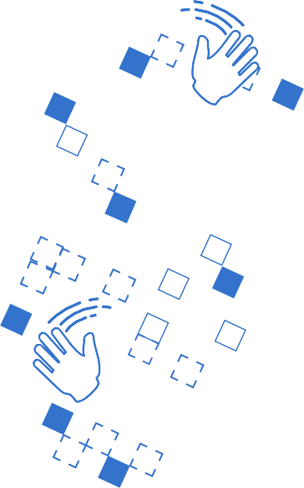



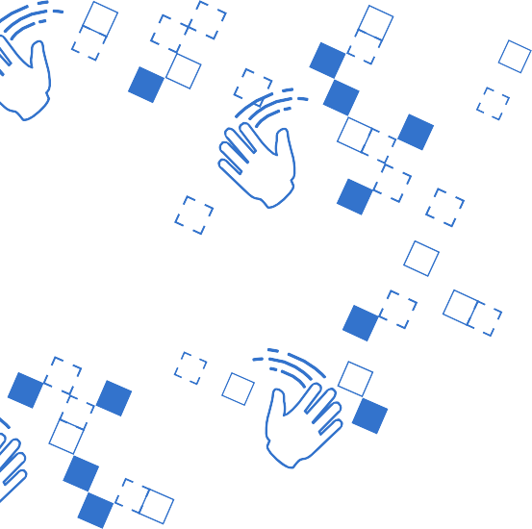


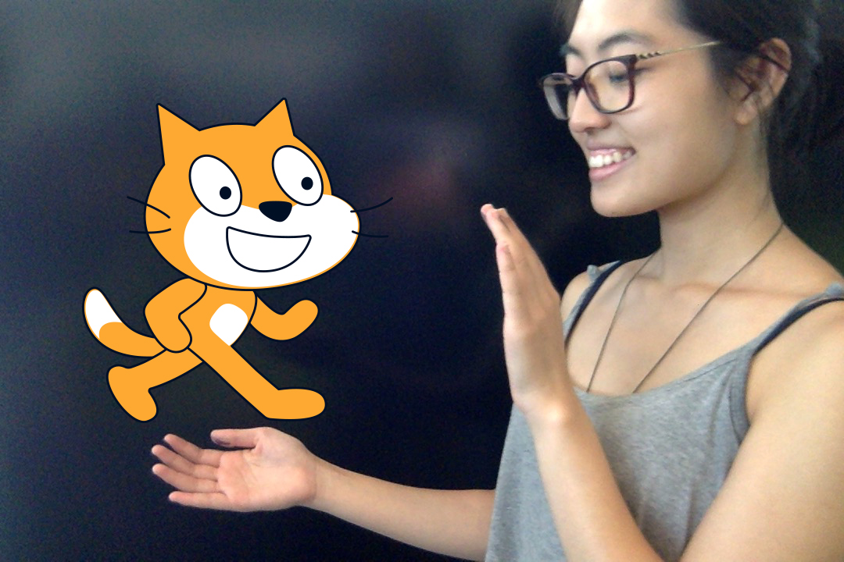
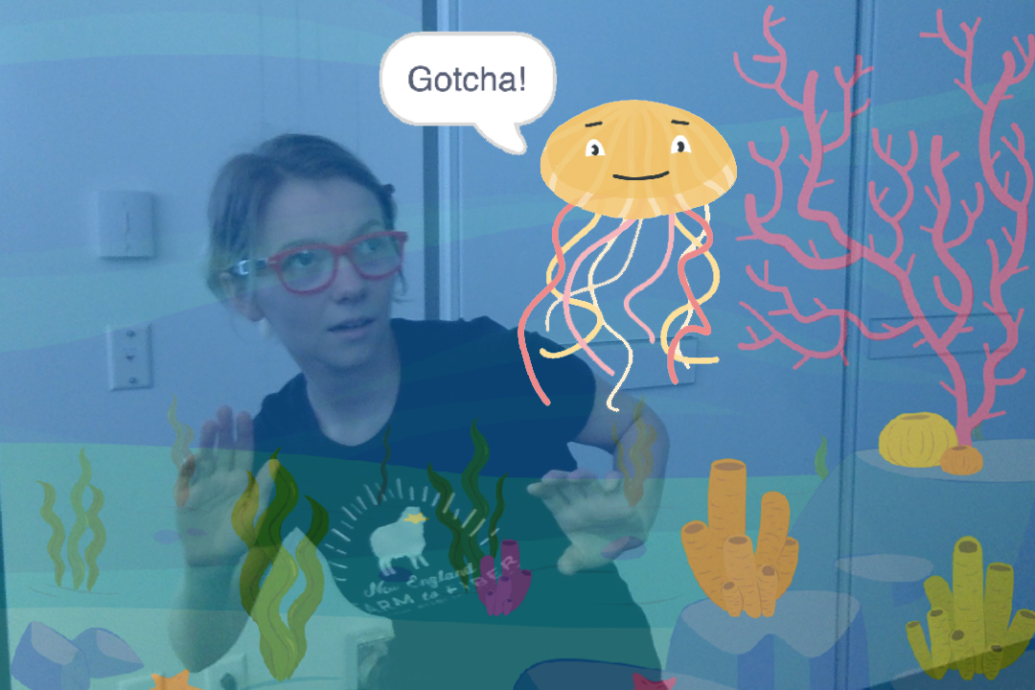




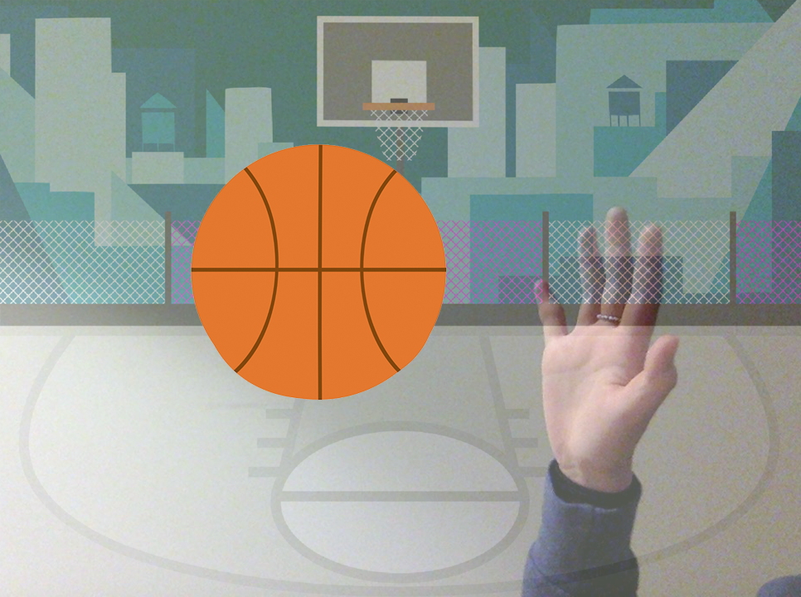





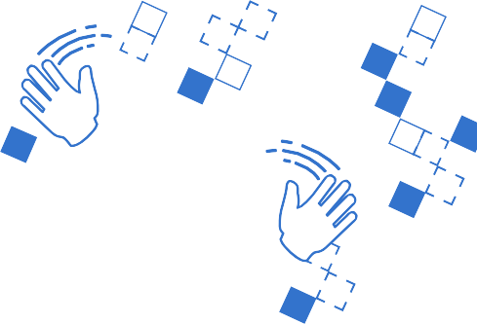








Video Sensing Cards
Interact with projects using video sensing.
yyyymmdd
scratch.mit.edu
Set of 7 cards

Slide 2
Video Sensing Cards
Try these cards in any order:
Pet the Cat
Animate
Pop a Balloon
Play the Drums
Keep Away Game
Play Ball
Start an Adventure
scratch.mit.edu
Set of 7 cards

Slide 3
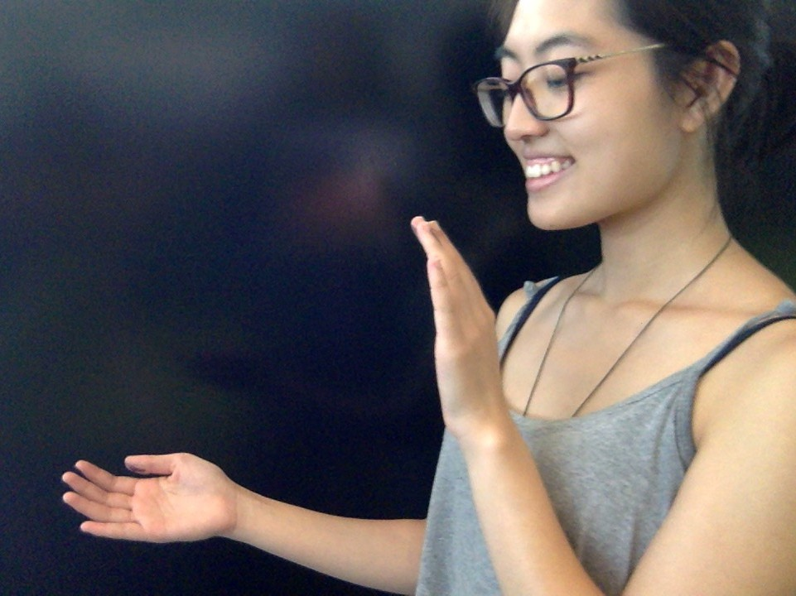
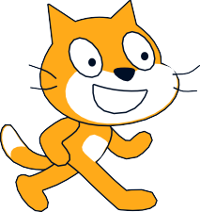

Pet the Cat
Make the cat meow when you touch it.
yyyymmdd
Video Sensing
1

Slide 4

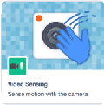

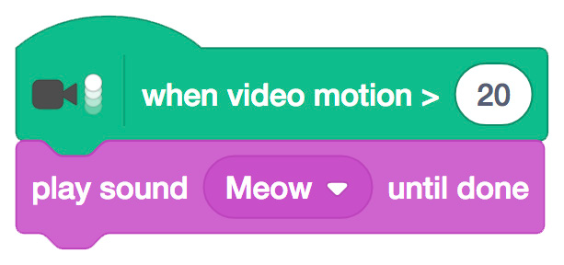
Pet the Cat
scratch.mit.edu
GET READY
Click the Extensions button (at the bottom left of the screen).
Choose Video Sensing
to add the video blocks.
ADD THIS CODE
This will start when it senses video motion on a sprite.
Type a number between 1 and 100 to change the sensitivity.
Cat
(1 will start with very little movement, 100 requires a lot of movement.)
TRY IT
Move your hand to pet the cat.

Slide 5


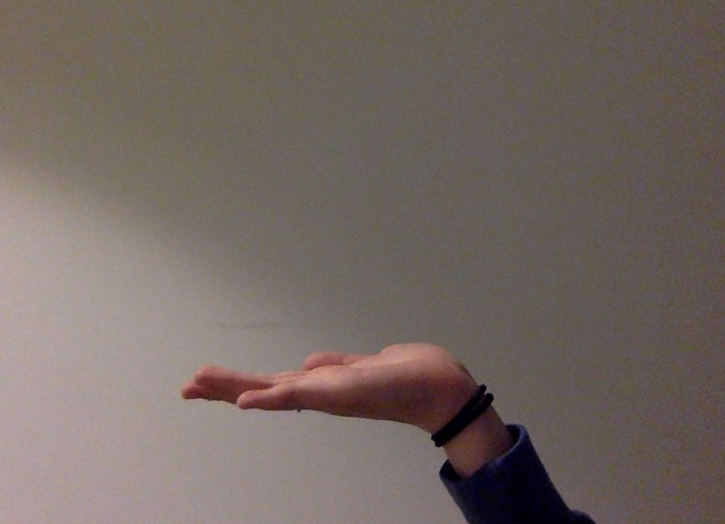

Animate
Move around to bring a sprite to life.
yyyymmdd
Video Sensing
2

Slide 6


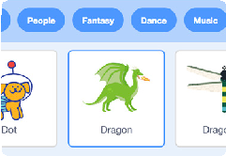

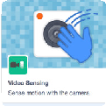
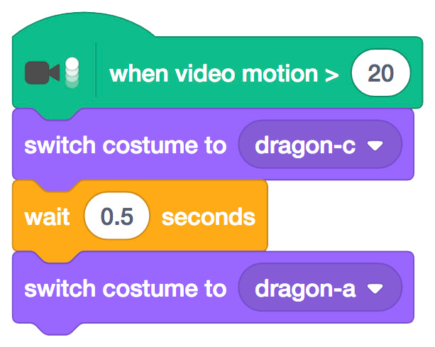

Animate
scratch.mit.edu
GET READY
Pick a sprite with more than one costume.
Click the Extensions button, then choose Video Sensing.
Choose a sprite to animate.
Scroll over sprites in the Sprite Library to see their different costumes.
ADD THIS CODE
__
__
Choose one costume.
Choose a different costume.
TRY IT
Move around to animate your sprite.

Slide 7




Pop a Balloon
Use your finger to pop a balloon.
yyyymmdd
Video Sensing
3

Slide 8

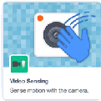


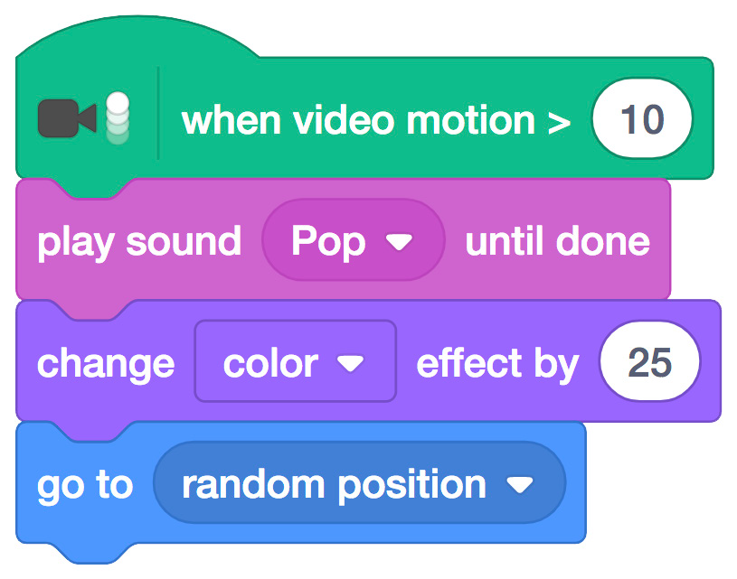

Pop a Balloon
scratch.mit.edu
GET READY
Click the Extensions button, then choose Video Sensing.
Choose a sprite, like Balloon1.
ADD THIS CODE
__
Type a larger number to make it harder to pop.
TRY IT
Use your finger to pop the balloon.

Slide 9
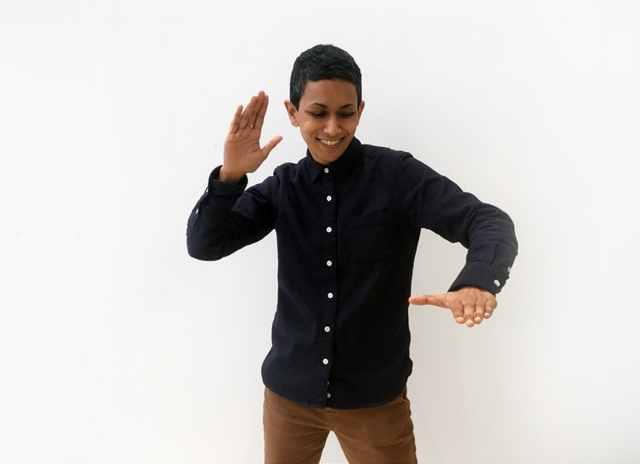

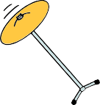

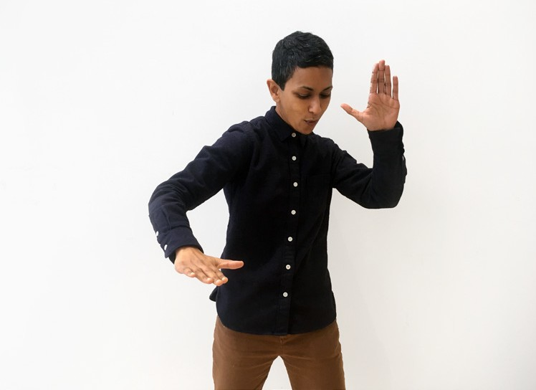

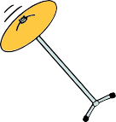

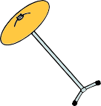
Play the Drums
Interact with sprites that play sounds.
yyyymmdd
Video Sensing
4

Slide 10

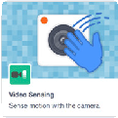




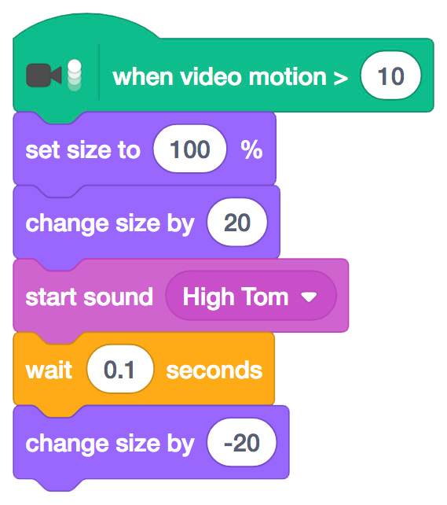
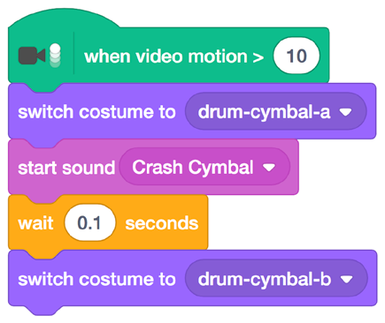
Play the Drums
scratch.mit.edu
GET READY
Drum
Drum-cymbal.
Click the Extensions button, then choose Video Sensing.
Choose two sprites,
like Drum and Drum-cymbal.
ADD THIS CODE
Click on a drum to select it, then add its code.
Drum
Drum-cymbal
Type a minus sign to get smaller.
Choose a different costume.
TRY IT
Use your hands to play the drums!

Slide 11



Keep Away Game
Move around to avoid a sprite.
yyyymmdd
Video Sensing
5

Slide 12

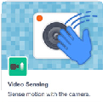





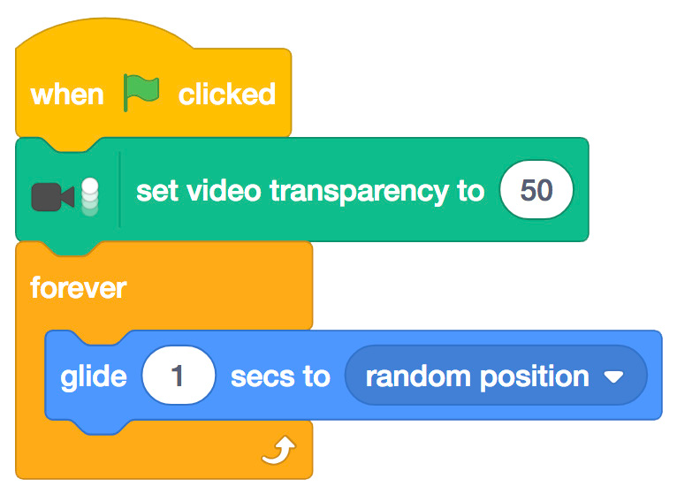
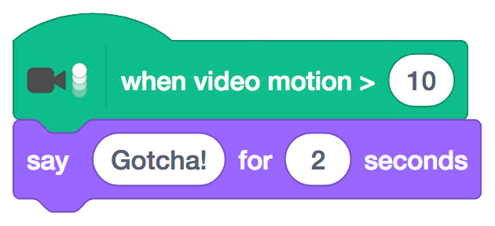
Keep Away Game
scratch.mit.edu
GET READY
Click the Extensions button, then choose Video Sensing.
Choose a backdrop, like Ocean.
Choose a sprite, like Jellyfish.
ADD THIS CODE
Type a number between 0 and 100.
(0 to show the video, 100 to make the video transparent.)
TRY IT
Move around to avoid the jellyfish.

Slide 13


Play Ball
Use your body to move a sprite across the screen.
yyyymmdd
Video Sensing
6

Slide 14

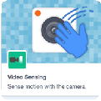

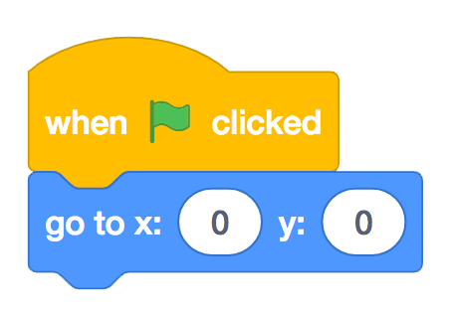

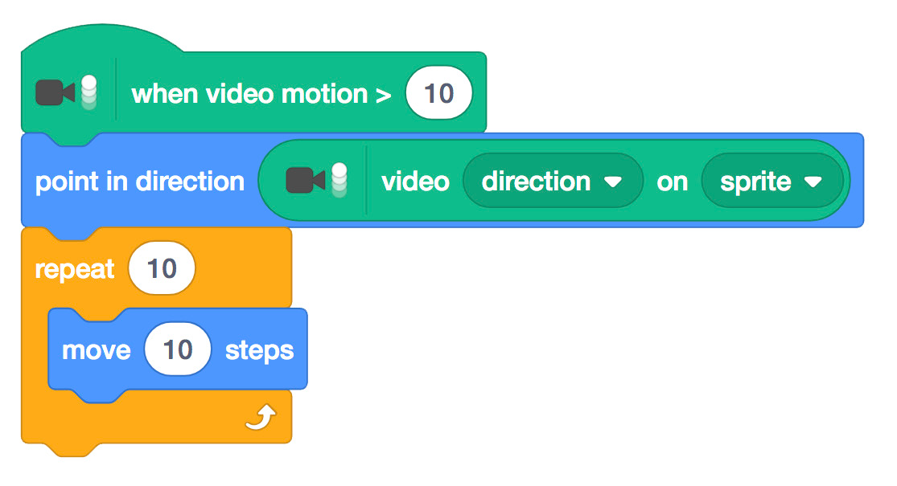
Play Ball
scratch.mit.edu
GET READY
Beachball
Click the Extensions button, then choose Video Sensing.
Choose a sprite, like Beachball.
ADD THIS CODE
Beachball
Choose direction
from the menu.
TRY IT
Use your hands to push the beach ball around the screen. Try it with a friend!

Slide 15
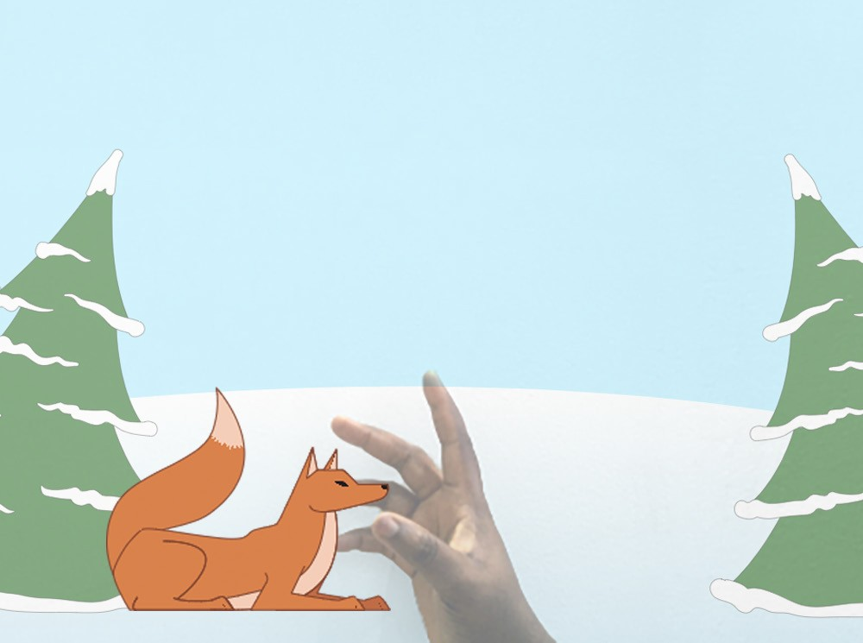
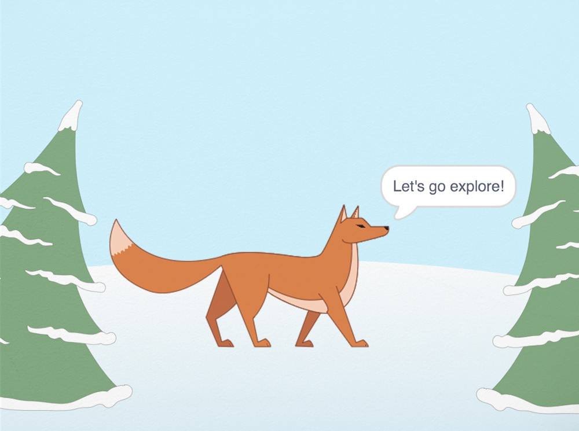
Start an Adventure!
Interact with a story by moving your hands.
yyyymmdd
Video Sensing
7

Slide 16


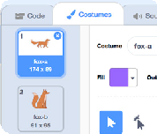
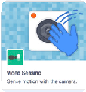



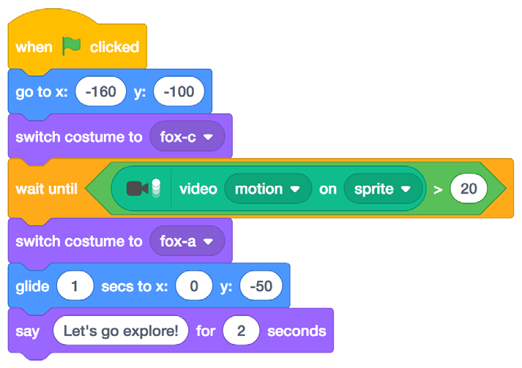


Start an Adventure!
scratch.mit.edu
GET READY
Click the Costumes tab to see your sprite's other costumes.
Click the
Extensions button.
Choose a backdrop.
Choose a sprite.
Winter
Fox
Choose Video Sensing.
ADD THIS CODE
Click the Code tab.
Set a starting point.
Choose a costume.
Insert the video motion on sprite block into
the greater than block from the Operators category.
Choose another costume.
Set the position your sprite will glide to.
TRY IT
Click the green flag.
Then wave to wake up the fox.

